Slide 1
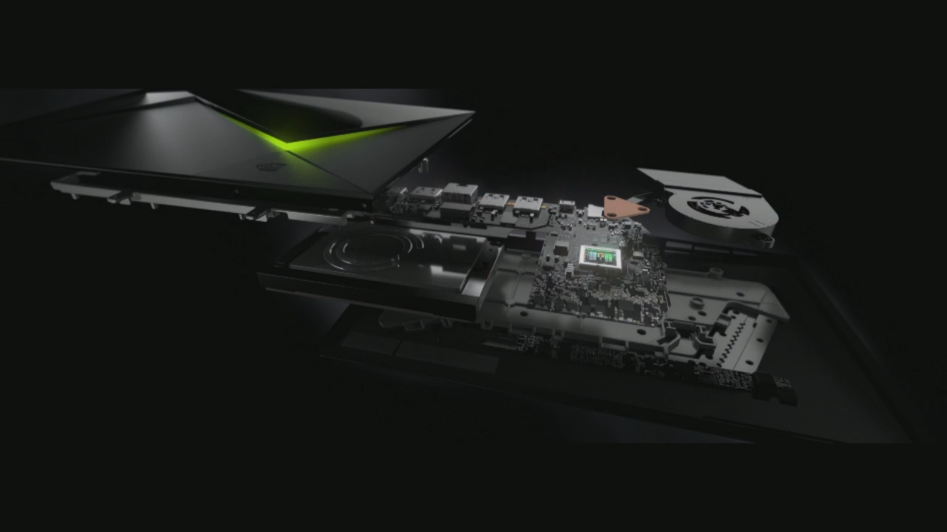
Introduction To
Parallel Programming with CUDA and PYTHON

Slide 2
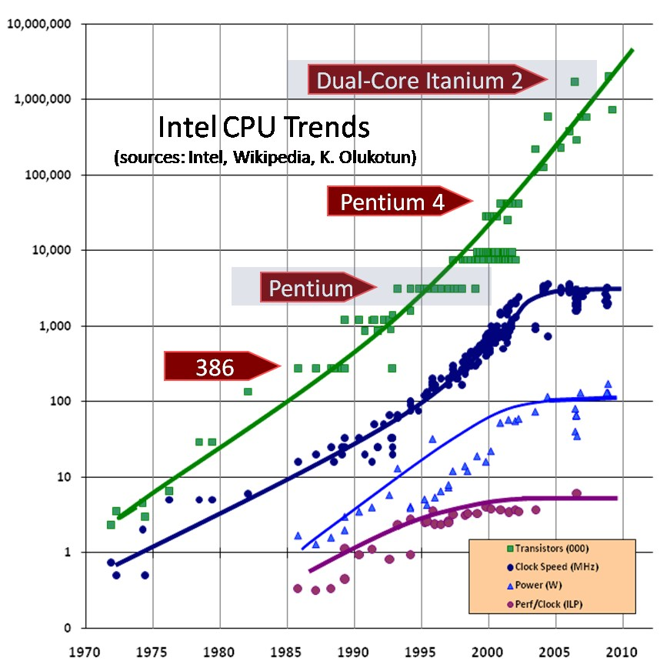
Why are GPGPU required ?
Disadvantege of CPU Scaling through
increasing clock frequecny.
What happened around year 2000?
Possible solution – Stick more CPUs in it!!
Year 2001, two companies AMD and Nvidia
launched Programmable GPUs.

Slide 3
Application of GPGPUs
Clusters of GPGPUs (Super Computers)
  Titan by Cray containing :
    18,688 AMD 16 core CPUs
    18,688 Nvidia K20x GPUs
    Total 693.6 TiB of RAM
GPU Machine Learning and Data Mining
Fast Fourier Transform
Image and Signal Processing
Video Processing
Environment Simulation

Slide 4
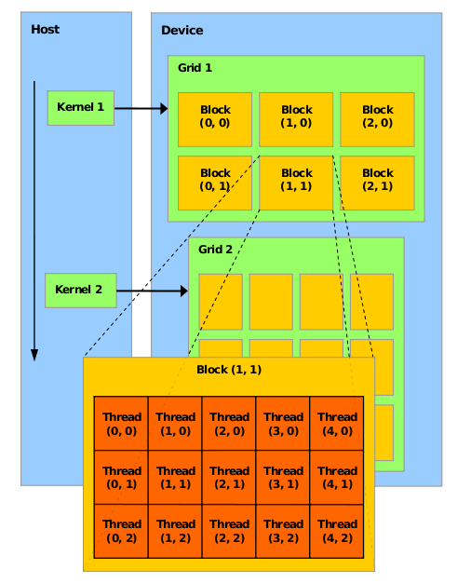
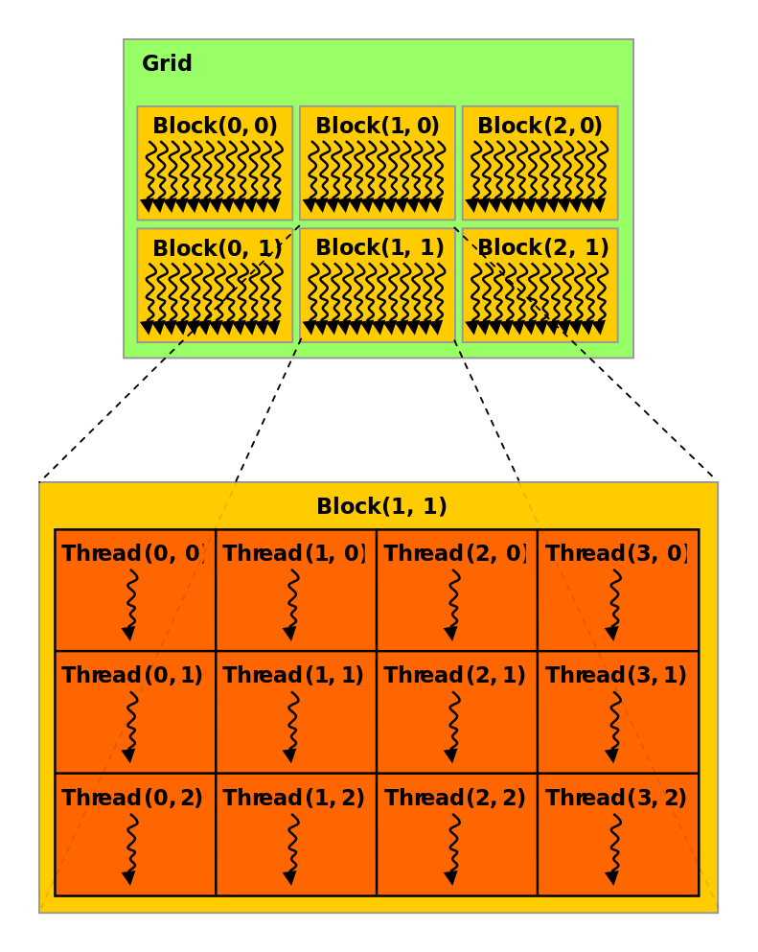
CUDA Architecture
Single Stream
Implicit _synchronize()

Slide 5
Memory Architecture
Bandwidth
Bandwidth
Local
Memory
Shared
Memory
Global
Memory
>
>>
Private to each thread
Shared among threads
in same Block
Common to every
thread

Slide 6
CUDA and Python through Numba
Advantages:
Can access numpy arrays directly in cuda kernel.
Supports running ufunctions parallely.
Most of the programming facilities exposed by Numba map directly to the CUDA C language offered by Nvidia
Provides a lot of abstraction to the CUDA subtelties.
Disadvantages:
Little slower.
Few missing features such as access to texture memory and dynamic shared memory.
Slow rate of updates

Slide 7
Simple Program
Addition of 1M floats.
Create array:
  a=np.arange(N,dtype=np.float32) “””N=1,000,000”””
Numpy Implementation
  sum=np.add(a,a) “”” Numpy uFunction “””
Cuda uFunction Implementation
@vectorize([‘float32(float32,float32)’],target=’cuda’)
def cuda_add(a,b):
  return a + b
out=cuda_add(a,a)

Slide 8
Cuda Kernel
  @cuda.jit(‘void(float32[:],float32[:],float32[:])’)
  def sum(a,b,out):
    thread_block_id=cuda.threadIdx.x
    block_id=cuda.blockIdx.x
    block_size=cuda.blockDim.x
    thread_global_id=thread_block_id + block_id * block_size
    if thread_global_id < a.size:
      out[thread_global_id]=a[thread_global_id]+b[thread_global_id]
You do not have to calculate thread id and block Id because THIS IS PYTHON!! ( Imagine Gerard Butler kicking someone into the pit )
  cuda.grid(ndim{1,2 or 3}) = cuda.threadIdx.x + cuda.blockIdx.x * cuda.blockDim.x
  cuda.gridsize(ndim{1,2 or 3}) = cuda.blockIdx.x * cuda.blockDim.x

Slide 9
How to call Cuda Kernel
function_name [<number_of_blocks>,<number_of_threads/block>](params)
The secret behind this weird syntax lies in the C implementation of CUDA provided by Nvidia
C Syntax:
functionName<<<NUM_of_BLOCKS,THREADS_per_BLOCK>>>(params)
Calling Function from previous slide
thrd_p_blk=32
num_of_blk=(N+thrd_p_blk-1)//thrd_p_blk (1000000+31)/32 =31250
Total threads = thrd_p_blk * num_of_blk = 1000000

Slide 10
Going Deep
Host Memory and Device Memory
Cuda API
copies host memory to device memory
  <var1>=cuda.to_device(<var>)
copies Device memory to host memory
  <var>=<var1>.copy_to_host()
creates non-initialized array similar to <var>
  <var1>=cuda.device_array_like(<var>)
[ Implementation of all the previously mentioned functions ]

Slide 11
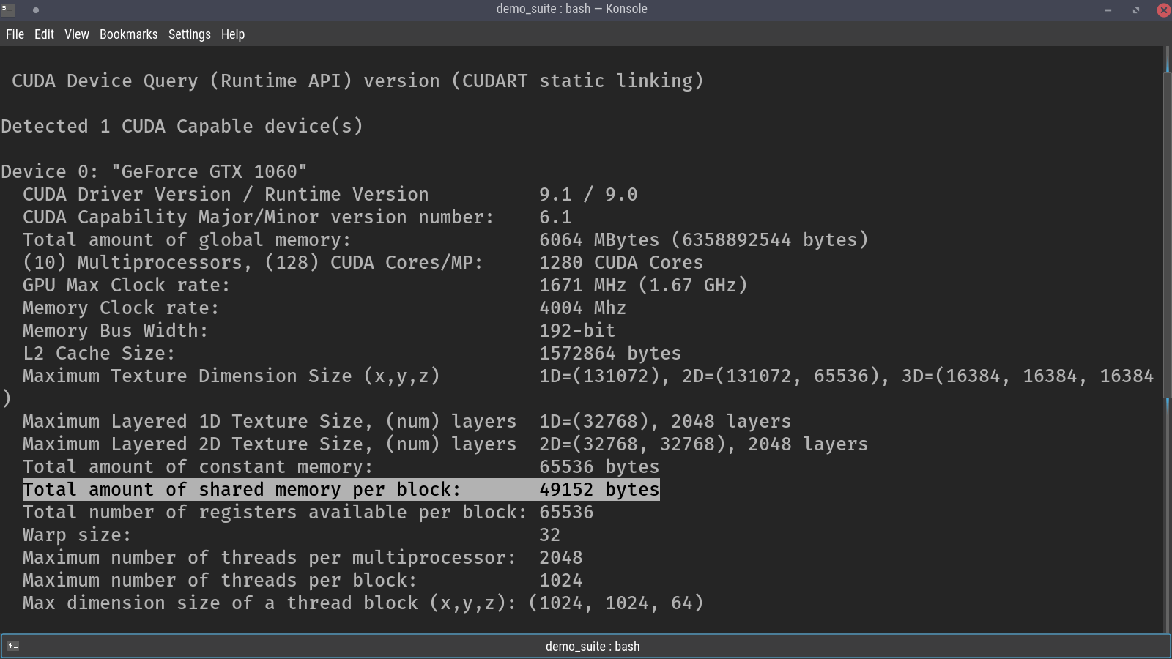
Using Different Memory Section
We have been using global memory till now
Shared Memory is way more faster than global memory but similar to the cache memory of CPU, it is limited.
On my device, its is
50KB/block.
Memory must be managed
while designing the ker-
-nel

Slide 12
Its Faster!!
The main reason for the function with shared memory being faster is , “Memory Coalescing”
  Highly simplified view:
0
256
Memory
Threads
0
256

Slide 13
What is WARP ?
We define the number of threads and number of blocks.
Scheduler assigns block to streaming processor.
Streaming processor divides threads into warp containing 32 threads ,each thread using same opcode but different operands (SIMD).
[ Implementation using shared Memory ]

Slide 14
Synchronization
Why is synchronization required?
Example parallel increment of an array of size 10
0 10 20 30
Race Condition
Read
Increment
store

Slide 15
How to synchronize?
cuda.syncthreads()
cuda.atomic.OP()
  Supported Ops
    add [Supported on int32, float32, and float64]
    max[Supported on int32, int64, uint32, uint64, float32, float64]
    min [Supported on int32, int64, uint32, uint64, float32, float64]

Slide 16
Finally
There are few Parallel algorithms that you should learn
  Map
  Reduce
  Scan
  Scatter
  Sort
  Gather
Check out for developer.nvidia.com for latest news and tutorials
https://github.com/ContinuumIO/gtc2017-numba

